Slide 1
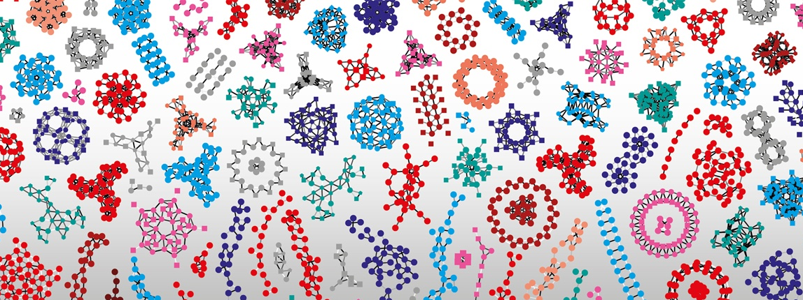

Introduction to RNA-Seq – Overview
Wandrille Duchemin
Notes:
1

Slide 2
First some logistics
Internet access :
- eduroam
- unibas-visitor > login page > get code with your phone
- Course from 09:00 to 17:00
- Lunch break 12:00 → 13:00
- 15min breaks around 10:30 and 15:00
Questions are welcome all the time
During practicals: post-its
I have a question/
problem
I am finished with
the practical

Slide 3
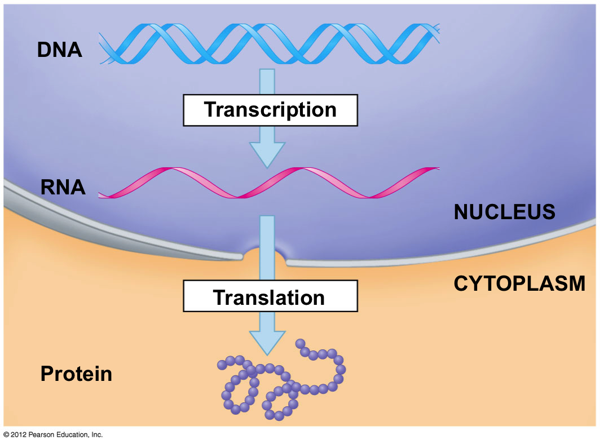
Nucleic acids everywhere
Notes:
<number>

Slide 4
A more complex model
complex interactions and regulations
E
N
V
I
R
O
N
M
E
N
T
DNA
RNA
Protein
Small molecules
Development and Physiology

Slide 5
A more complex model
alternative splicing
DNA
RNA
Protein
Small molecules
Development and Physiology
https://en.wikipedia.org/wiki/Alternative_splicing#/media/File:DNA_alternative_splicing.gif

Slide 6
A more complex model
alternative splicing
DNA
~20,000 mammalian genes
RNA
Protein
>>100,000 (?) transcripts
>>>1,000,000 (??) proteins
Small molecules
Cellular Diversity
Development and Physiology
https://en.wikipedia.org/wiki/Alternative_splicing#/media/File:DNA_alternative_splicing.gif

Slide 7
A more complex model
- sequencing nucleic acids
DNA
describe or quantify
RNA
Protein
mRNA levels :
proxy of a proxy
of cell physiology
Small molecules
Small molecules
Development and Physiology
Development and Physiology

Slide 8


What (and why) are we sequencing?
Genomics
Whole genome/exome sequencing (WGS, WES)
SNPs / CNVs / Structural variations
Epigenomics
Bisulphite sequencing : DNA methylation
ChIP-seq : TF binding sites
ATAC-Seq : chromatine opening
Transcriptomics
Total RNA
PolyA-tail selection : focus on mRNA
Ribo depletion : mRNA + non-coding RNAs
5’/3’ RACE seq : focus on a single gene’s isoforms
Single cell sequencing
...
Notes:
<number>

Slide 9
What (and why) are we sequencing?
Genomics
Whole genome/exome sequencing (WGS, WES)
SNPs / CNVs / Structural variations
Epigenomics
Bisulphite sequencing : DNA methylation
ChIP-seq : TF binding sites
ATAC-Seq : chromatine opening
Transcriptomics
Total RNA
PolyA-tail selection : focus on mRNA
Ribo depletion : mRNA + non-coding RNAs
5’/3’ RACE seq : focus on a single gene’s isoforms
Single cell sequencing
...
Imagination is the limit!
A longer but non exhaustive list :
https://liorpachter.wordpress.com/seq/
Notes:
<number>

Slide 10
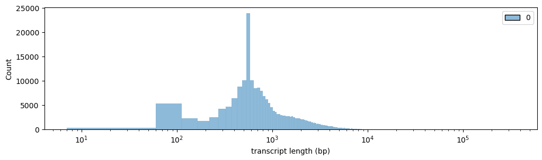
Some challenges for RNA-Seq
Transcripts are diverse in size
Human annotated transcripts

Slide 11
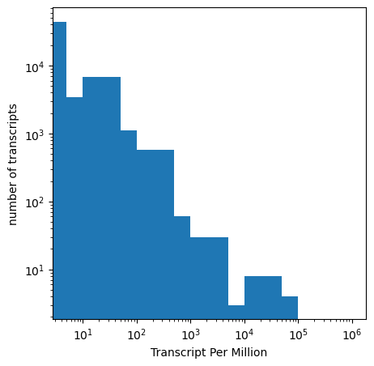
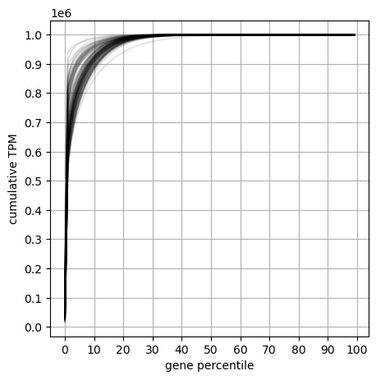
Some challenges for RNA-Seq
Transcripts are diverse in size
Expression levels have a high dynamic range
Gtex V8 - human tissue samples
Data source: https://gtexportal.org/home/datasets

Slide 12
Some challenges for RNA-Seq
Transcripts are diverse in size
Expression levels have a high dynamic range
RNA molecules are exposed to degradation enzymes
RNA integrity affects results
Is there a reference genome?
Yes : how good?
No : transcriptome assembly
How good is gene annotation?

Slide 13
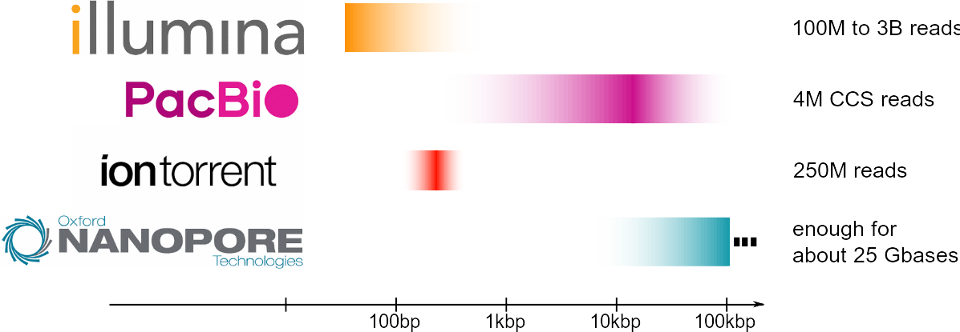
Main sequencing technologies
Read length

Slide 14
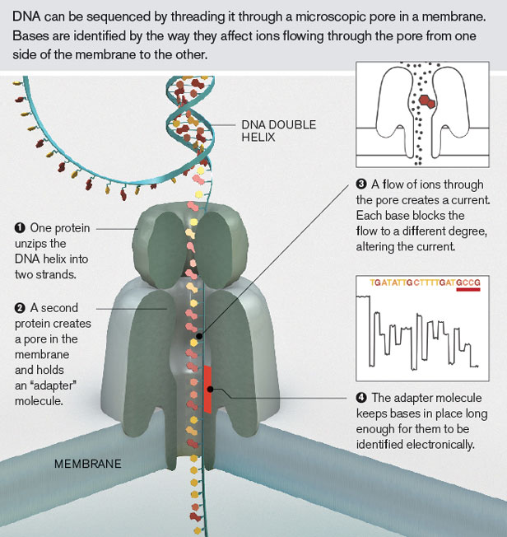
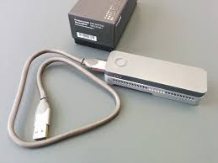
Oxford Nanopore – direct DNA/RNA sequencing

Slide 15
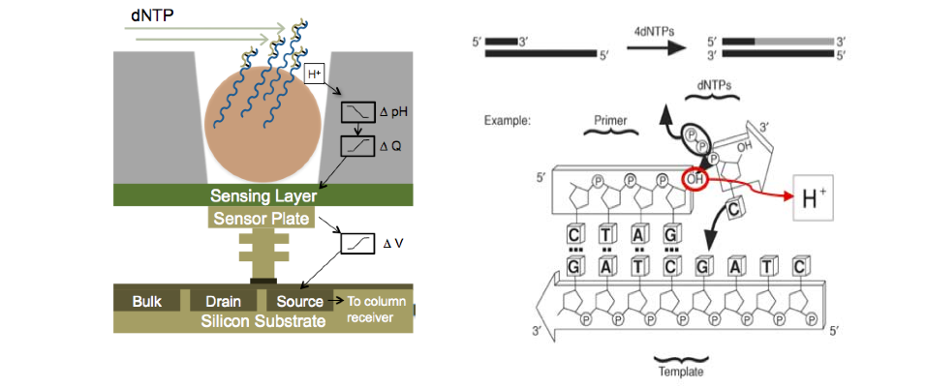
Ion torrent – reading pH changes

Slide 16
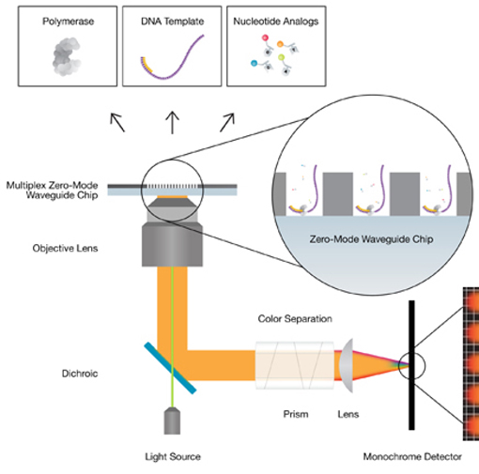
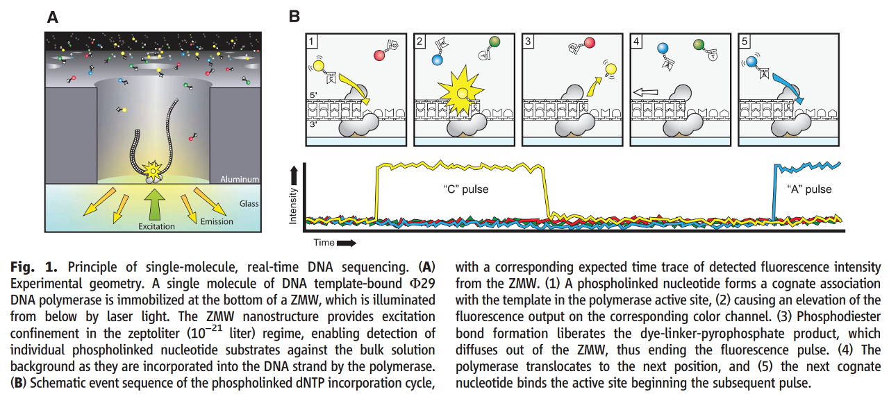
Pacific Biosciences – Single Molecule Real Time sequencing
Rhoads & Au.
Genomics Proteomics Bioinformatics 2015

Slide 17
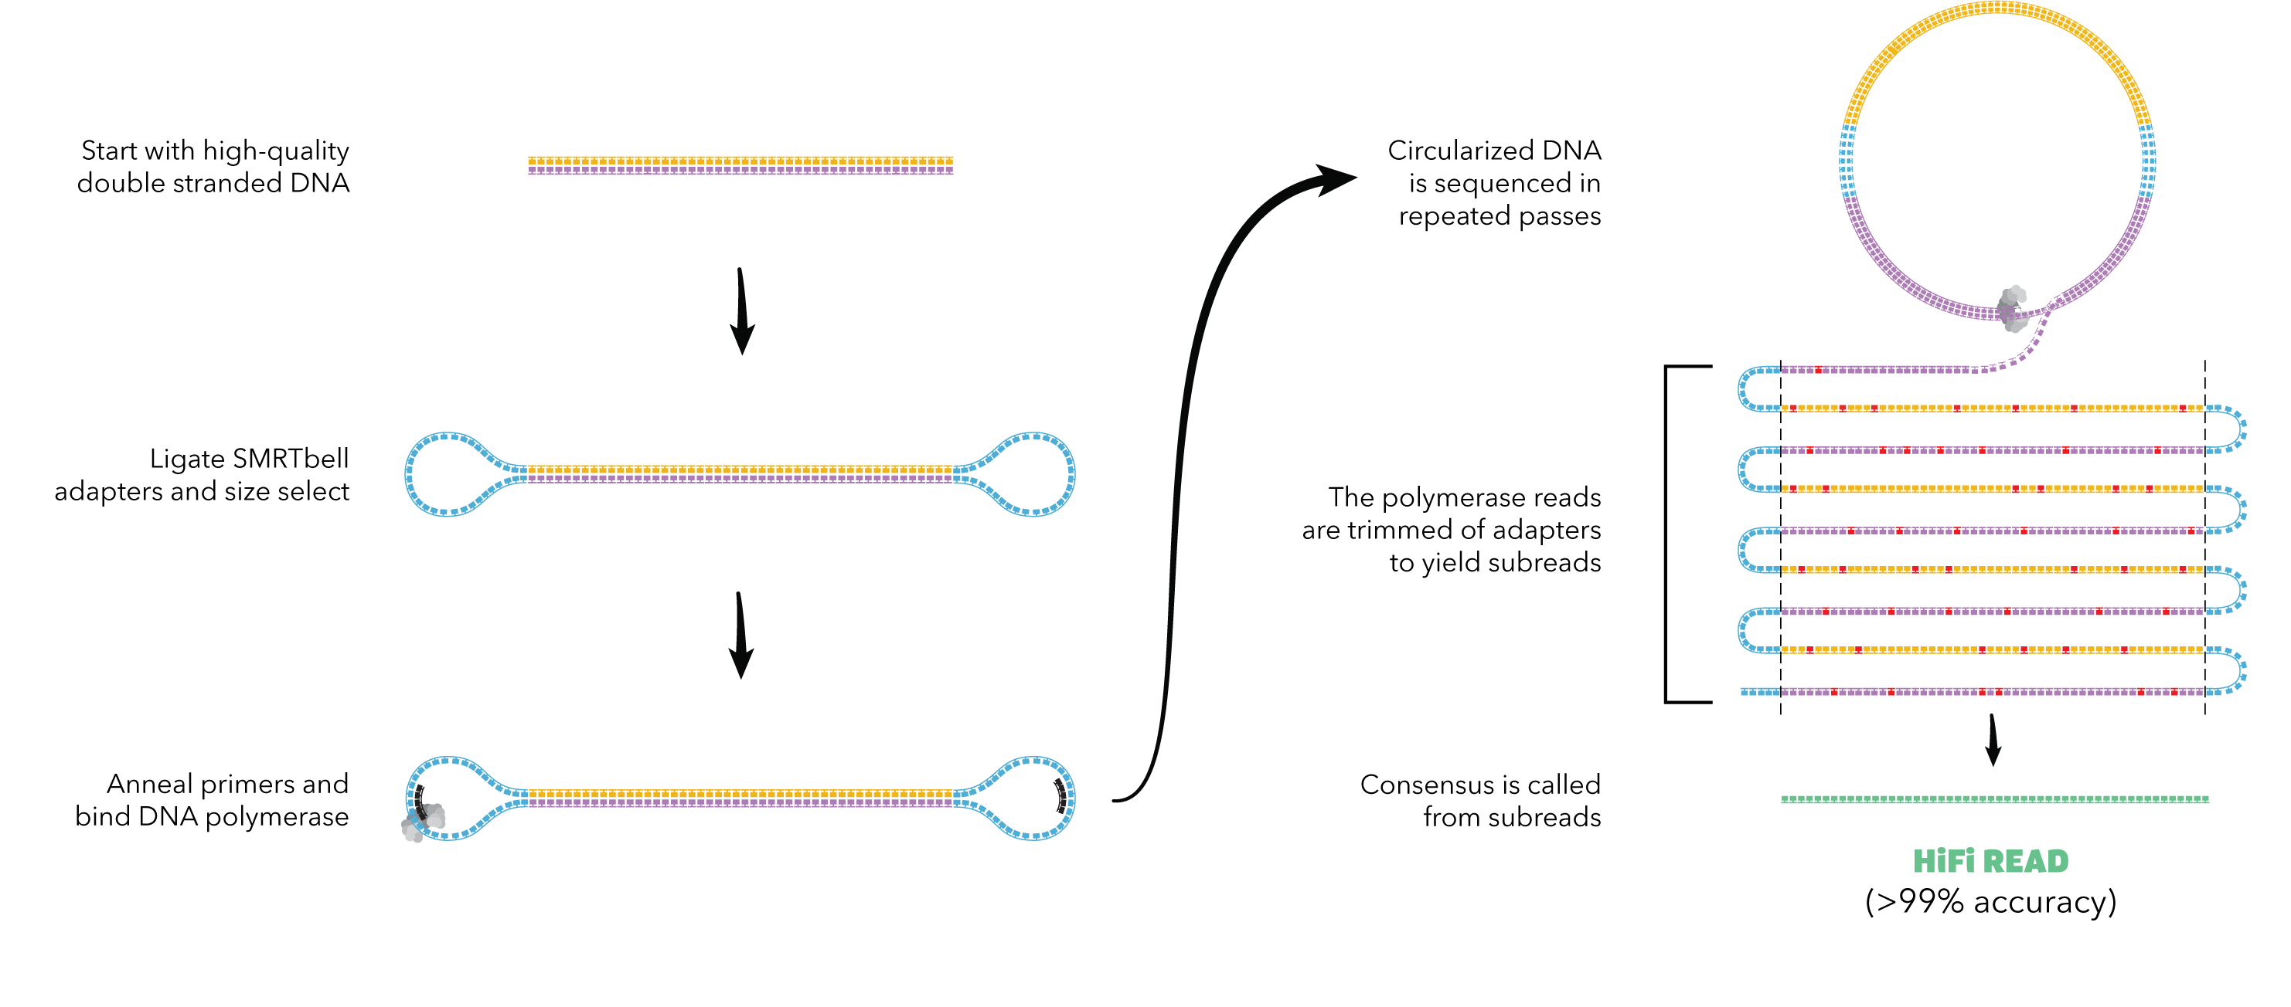
Pacific Biosciences – Circular Consensus Sequencing
Raw reads : 15% random errors
→ CCS strategy
Typical in isoseq

Slide 18
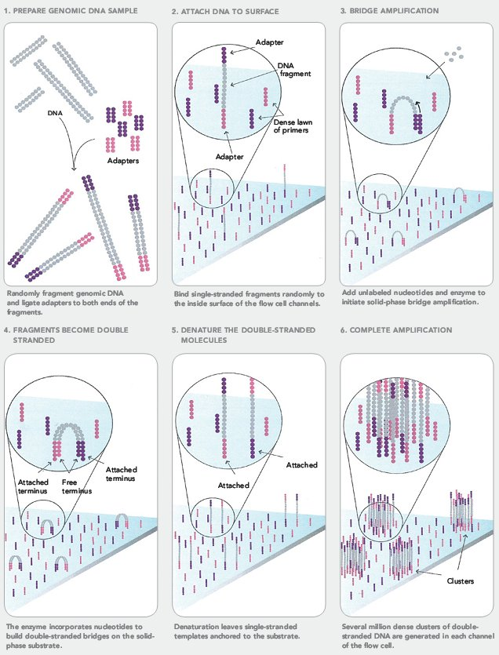
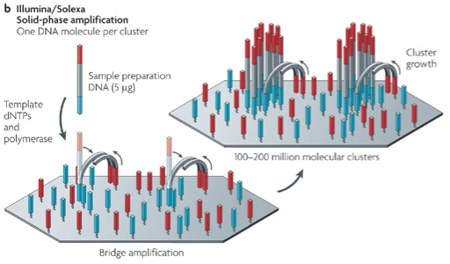
Illumina sequencing – “cluster formation”

Slide 19
Illumina sequencing – “cluster formation”
Source: Fig1b of Metzker, M. Sequencing technologies — the next generation.
Nat Rev Genet 11, 31–46 (2010). https://doi.org/10.1038/nrg2626

Slide 20
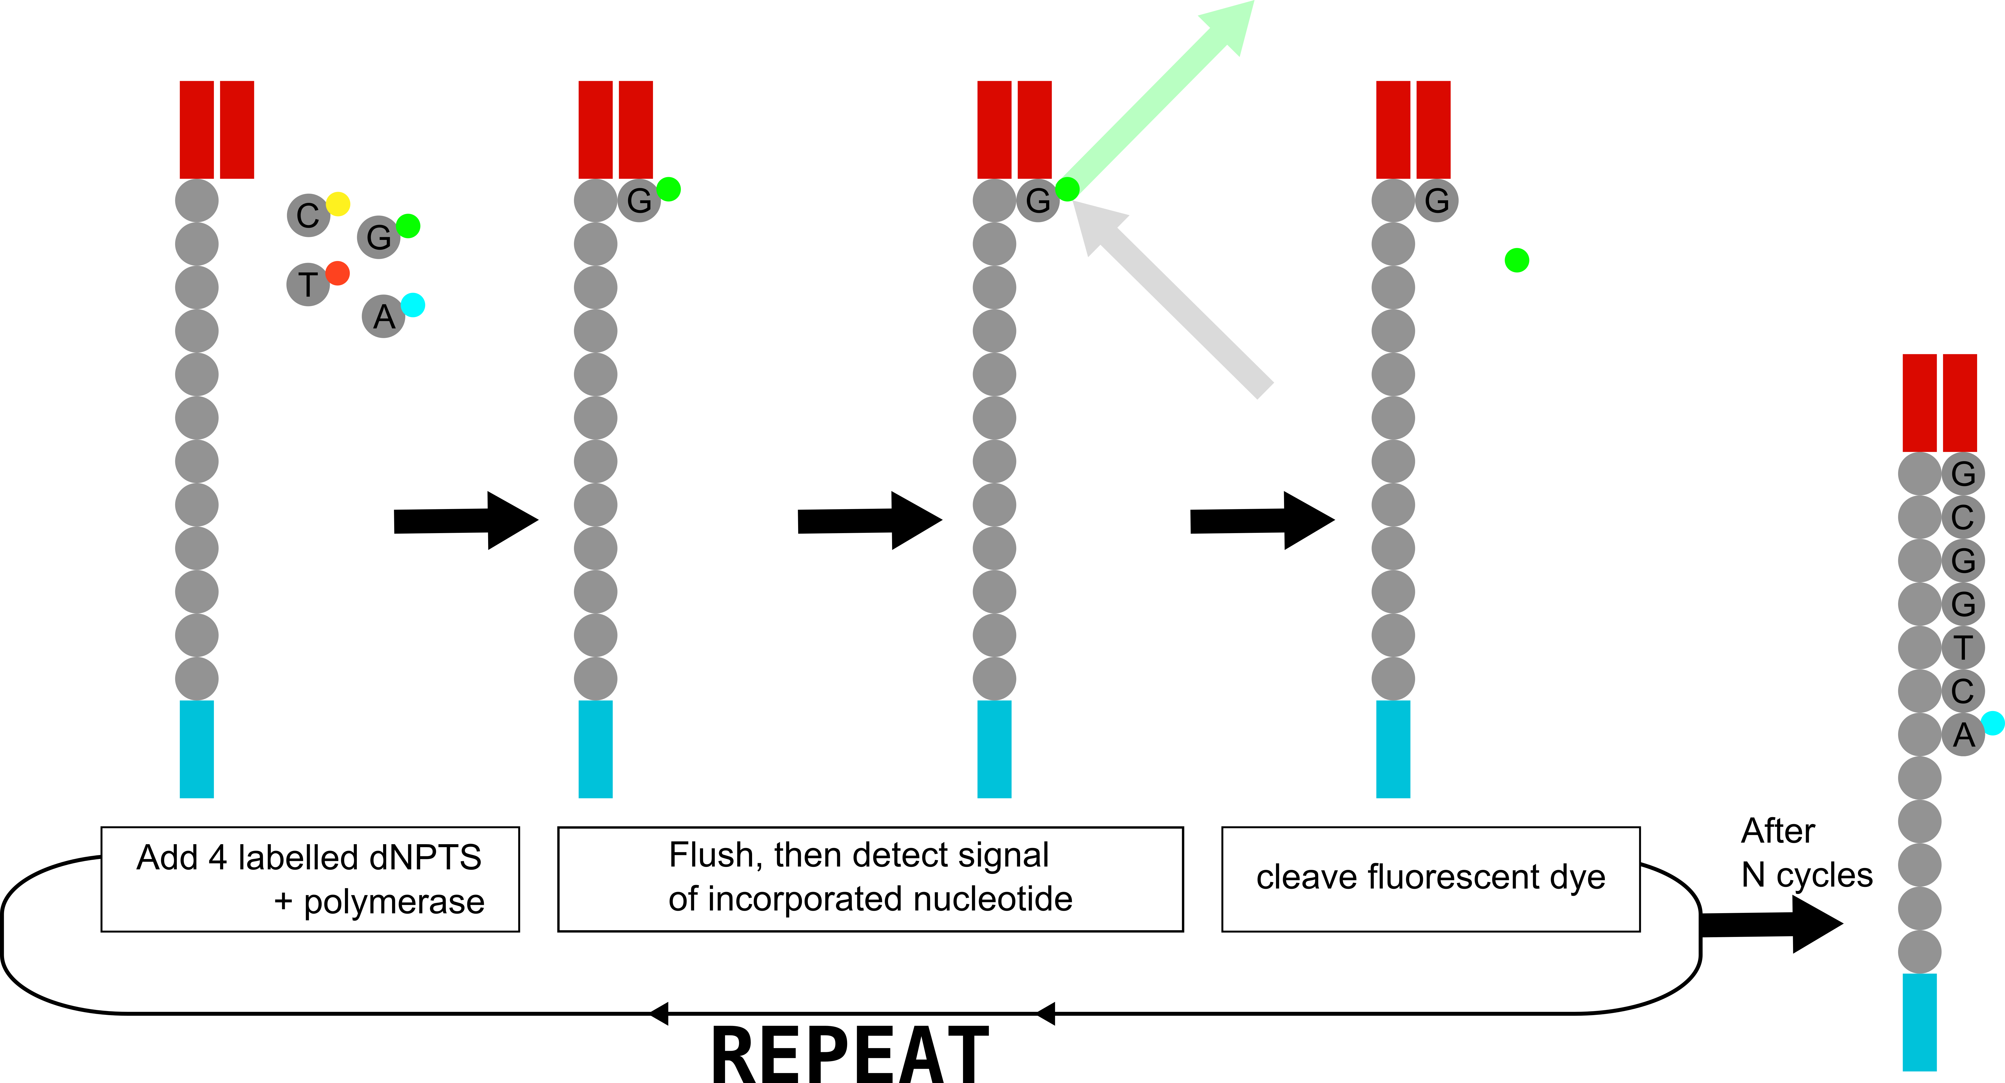
Illumina sequencing – “sequencing by synthesis”

Slide 21
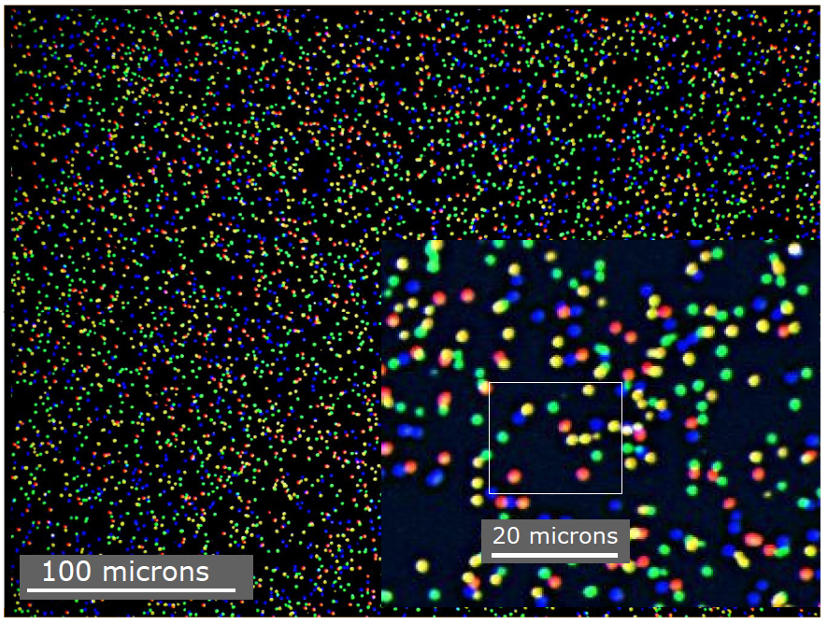
Illumina sequencing – image analysis
On the fly, instrument-associated software

Slide 22
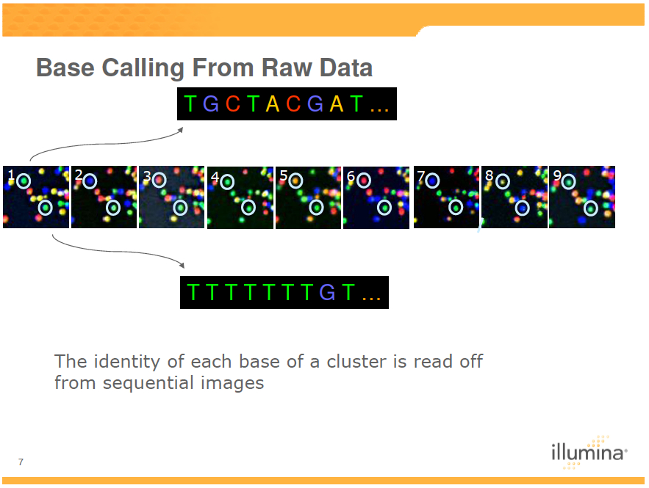
Illumina sequencing – from image to sequence

Slide 23
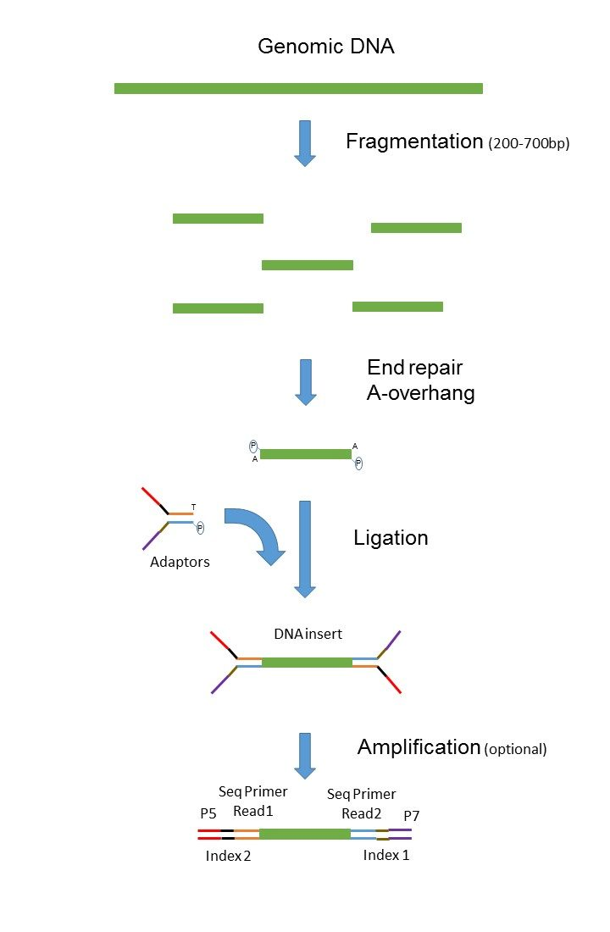
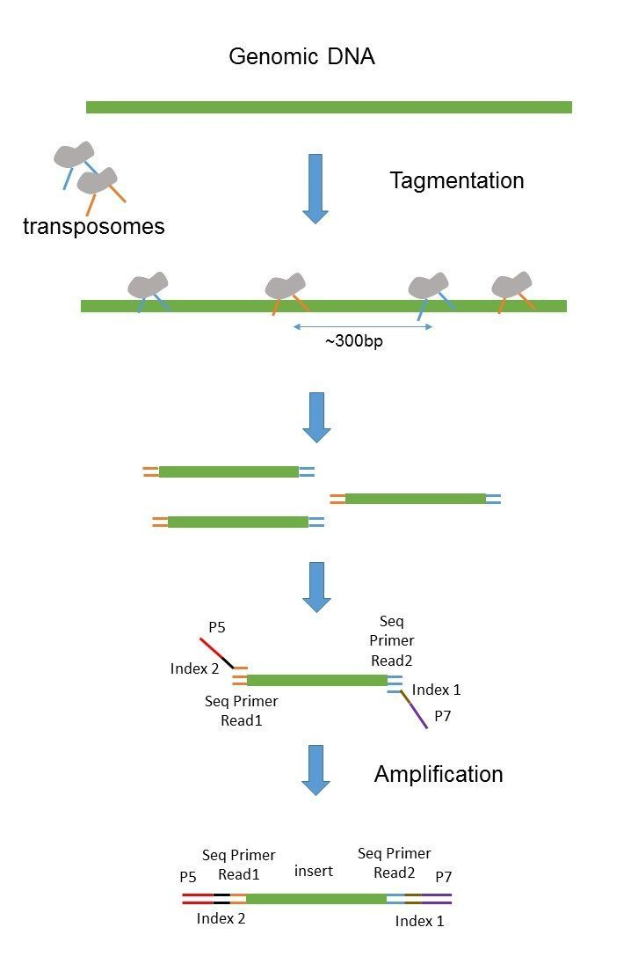
Paired-end sequencing
“Classical” paired end library (illumina)
“Nextera” paired end library
Source : France Genomique

Slide 24
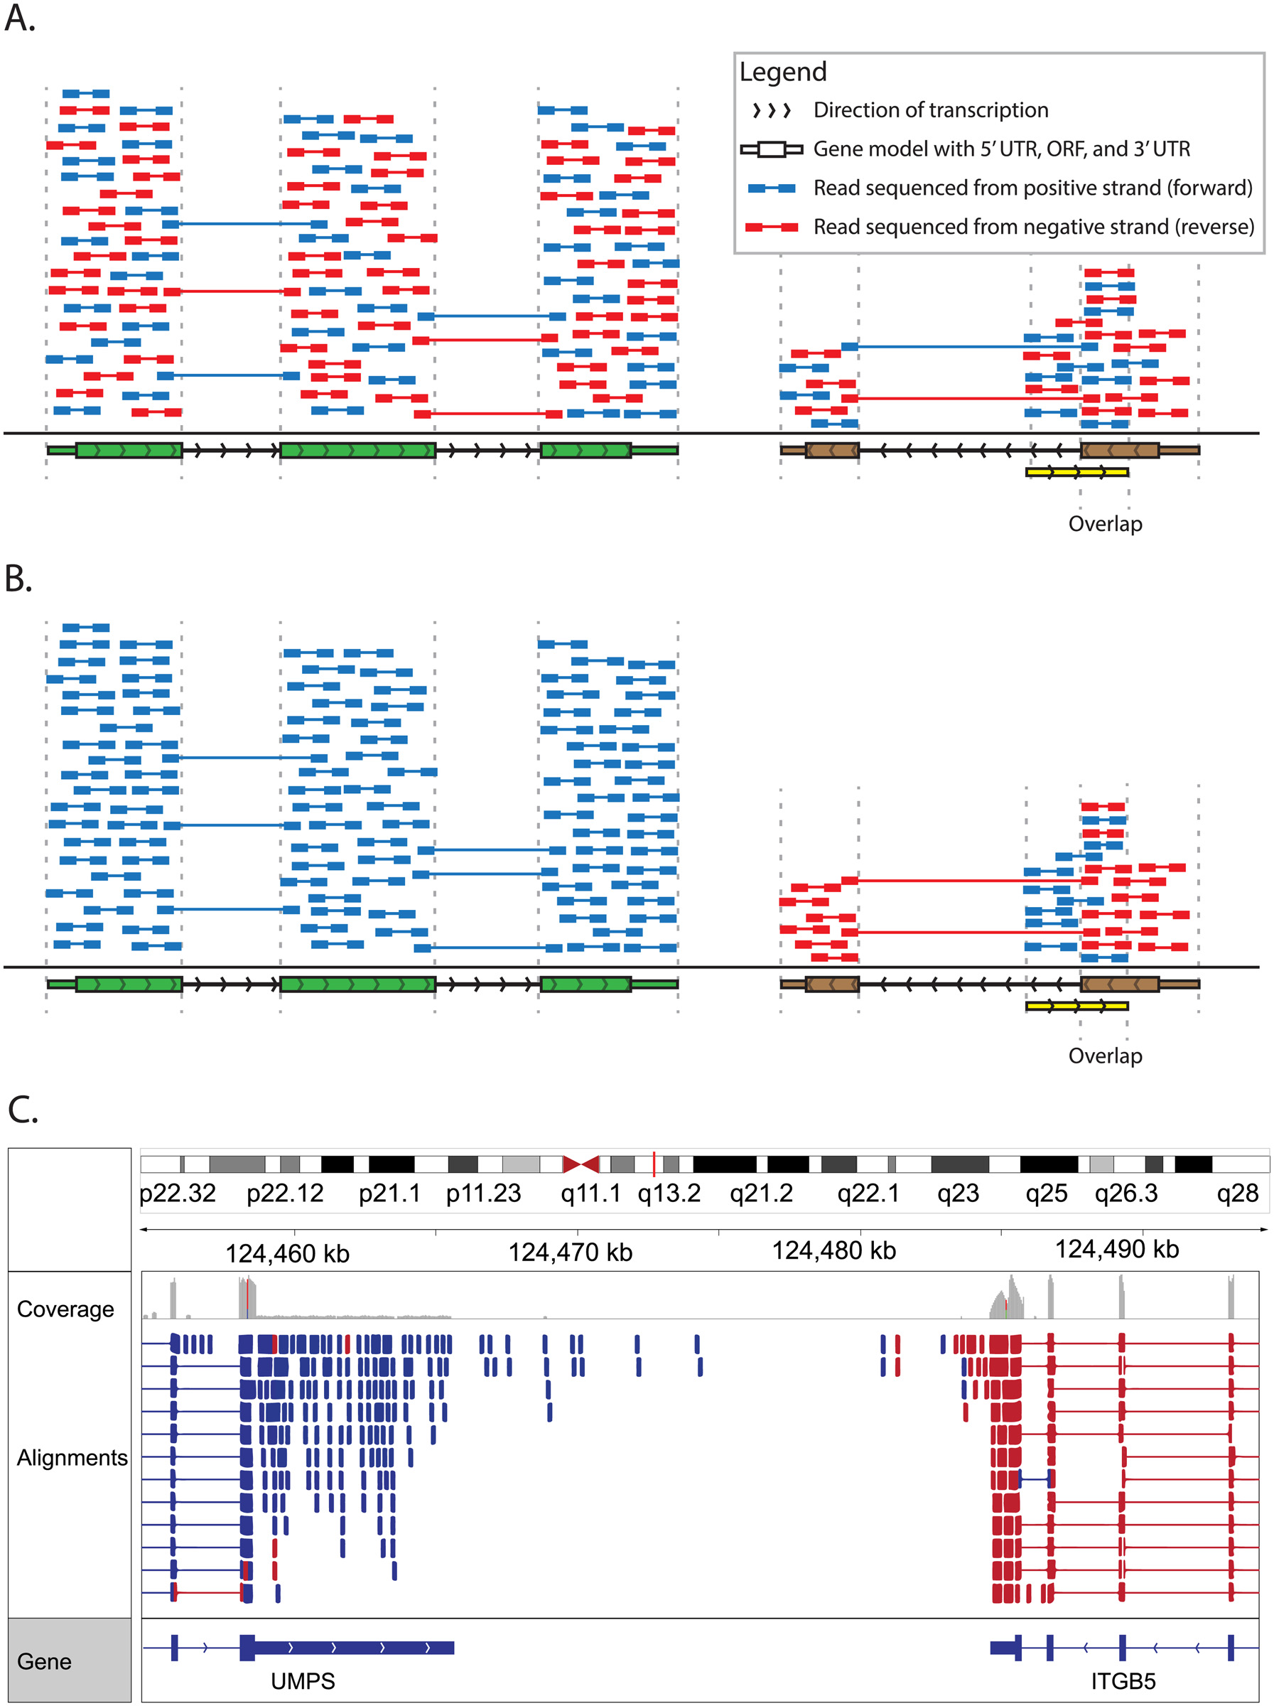
Stranded vs Unstranded Sequencing
A substantial proportion of the genome is transcribed in both directions (~8% in Homo sapiens)
Read strand information = quantify expression on overlaps
Achieved by ligating different adaptors to the 5’ and 3’ ends
M.Griffith et al.
PLoS Comp Biol 2015
doi:10.1371/journal.pcbi.1004393
Notes:
<number>

Slide 25
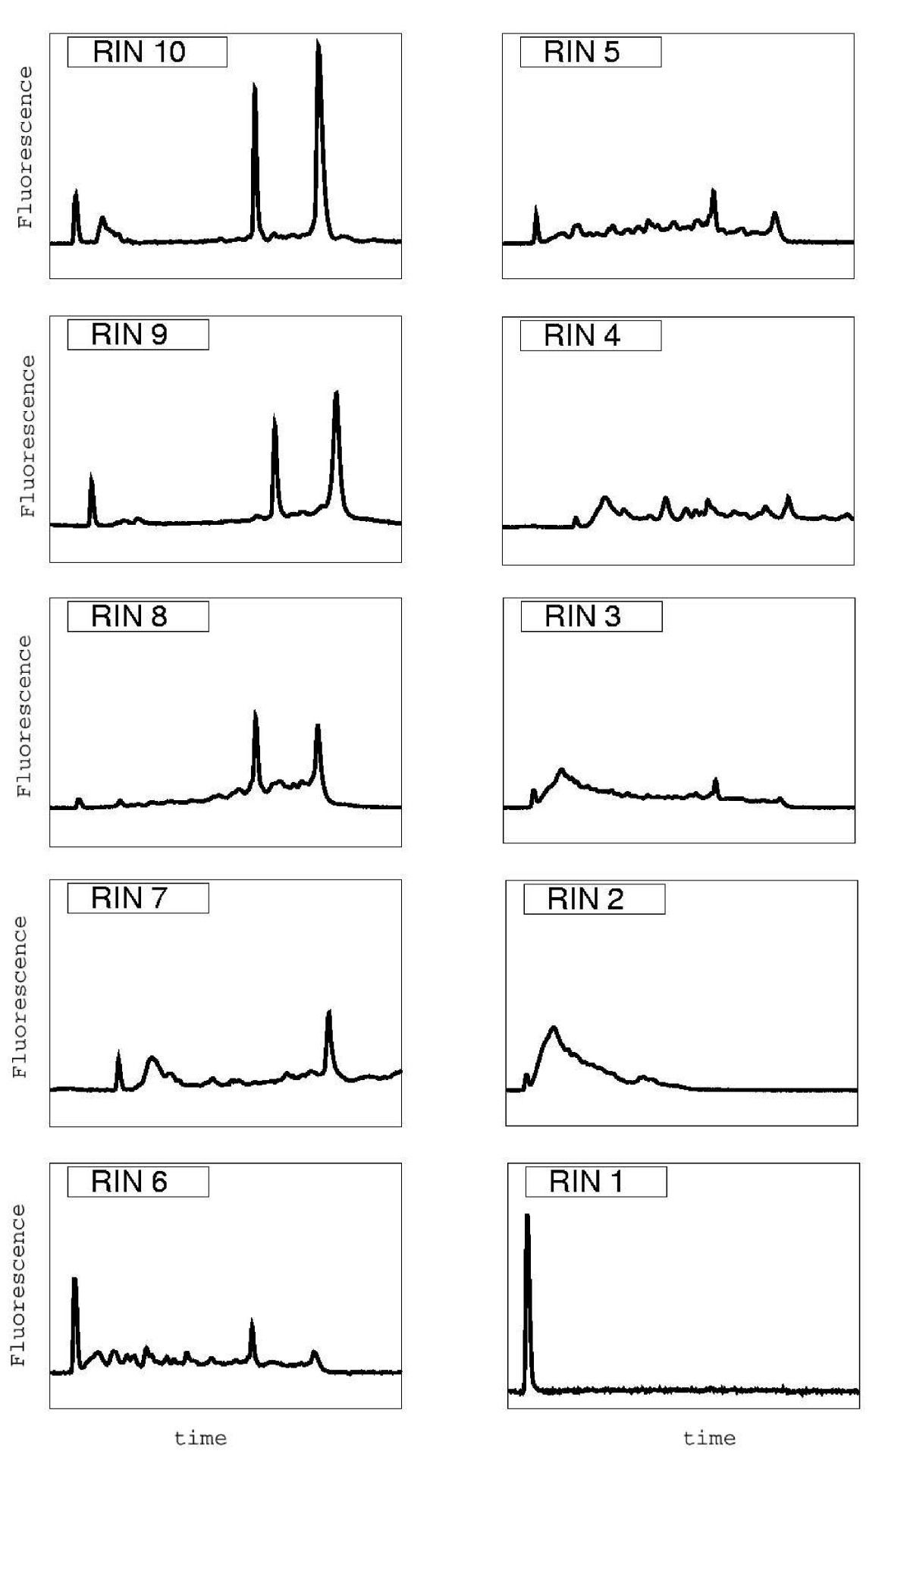
RNA Sample Preparation – RNA isolation
Critically important → cannot make up for poor data!
RNA integrity number (RIN) estimates integrity based on the Agilent profile
Minimum:
7 or 8 (eukaryot mRNA)
9 (bacterial )
Schroeder et al BMC Mol Biol 2006

Slide 26
RNA-Seq Preparation - Purification
PolyA selection
Commonly used and inexpensive
3’ end bias when RNA is degraded
Loses almost all non-polyA transcripts
Gets rid of vast majority of ribosomal RNAs
Ribosomal RNA depletion
Less popular, ~2X more expensive
Higher proportion of rRNA compared to polyA selection
Bacterial data (no polyA tails)
Allows identification of lncRNAs without polyA tails

Slide 27
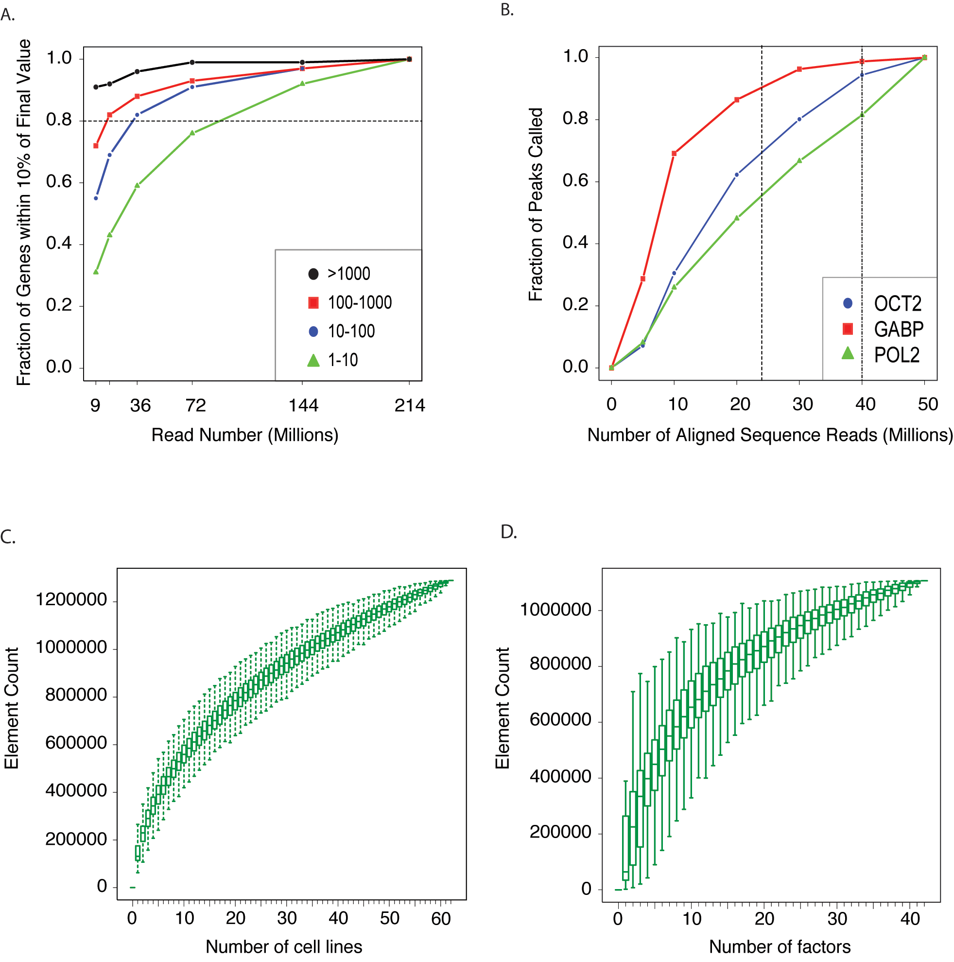
Sequencing depth
DE: usually aim for ~30-40 million reads
RPKM class
For rare events (isoforms, somatic mutations) much more depth is required
Not easy to know in advance
A User's Guide to the Encyclopedia of DNA Elements (ENCODE) PLoS 2011

Slide 28
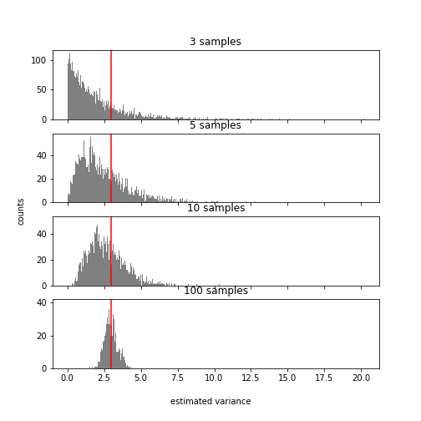
Replicates - estimating a biological variance
True variance = 3
What does this tell you about the ideal number of replicates for your RNA-Seq experiment?

Slide 29
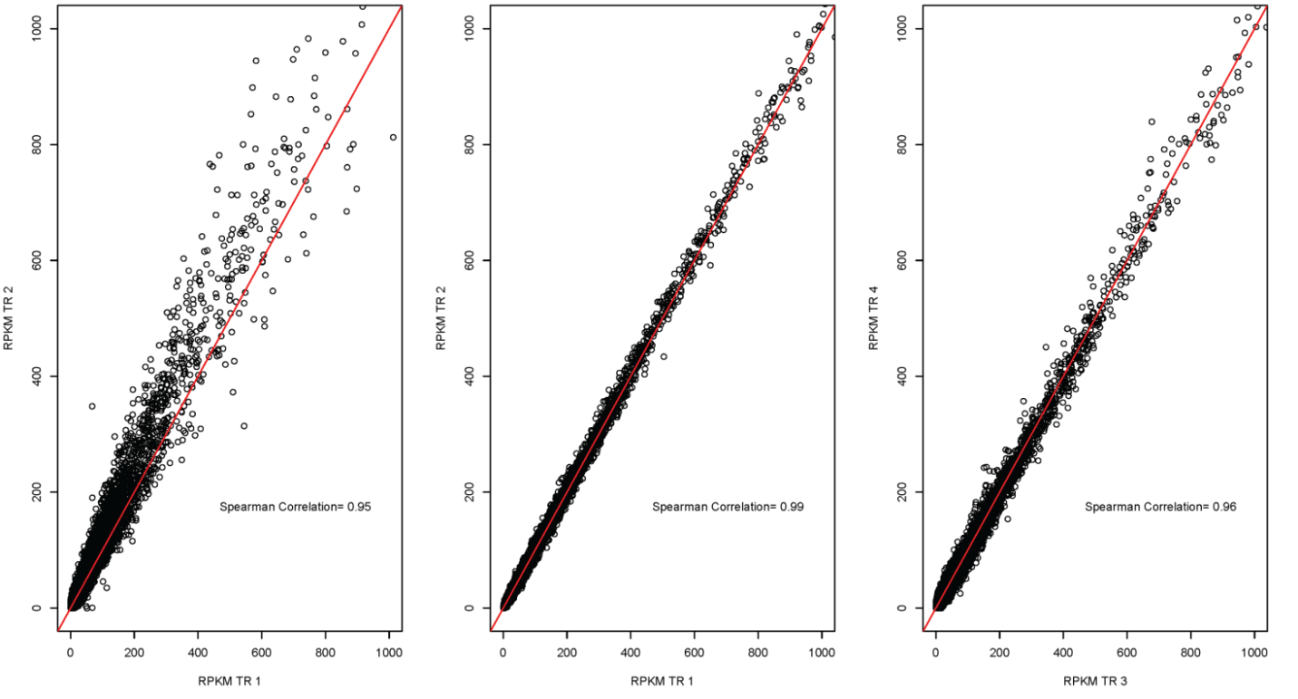
Technical replicates – generally not required
D. simulans male heads BR2
D. melanogaster female heads BR2
c167 cell line
Lauren M Mclntyre et al., BMC Genomics 2011
Notes:
<number>

Slide 30
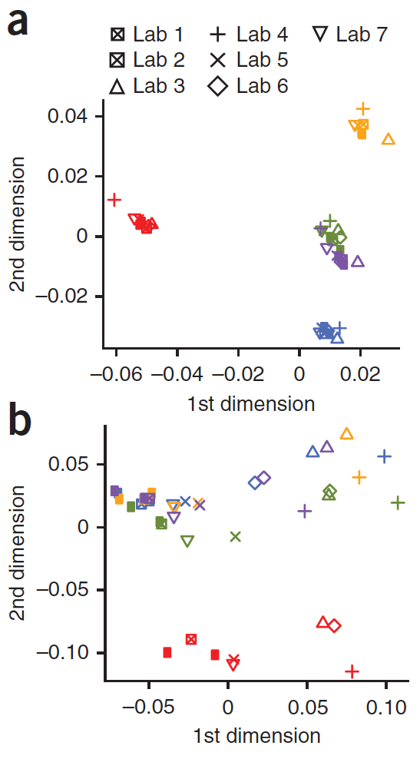
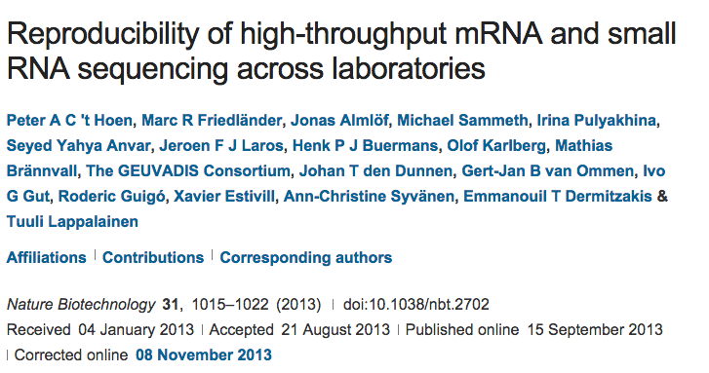
Experimental replicates – interlaboratory variation
7 labs, five shared samples, same library kit, paired-end reads of same length
Exon level : reproducible.
Notes:
<number>

Slide 31
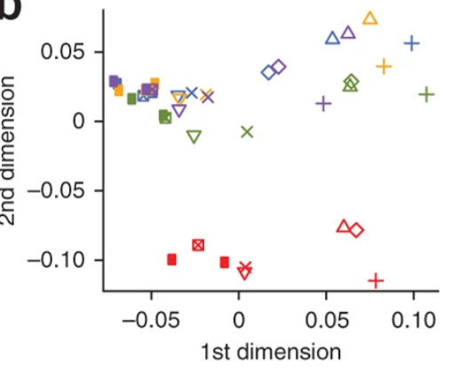
Experimental replicates – interlaboratory variation
7 labs, five shared samples, same library kit, paired-end reads of same length
Transcript level : reproducible.
CHECK FOR BATCH EFFECT!
Notes:
<number>

Slide 32
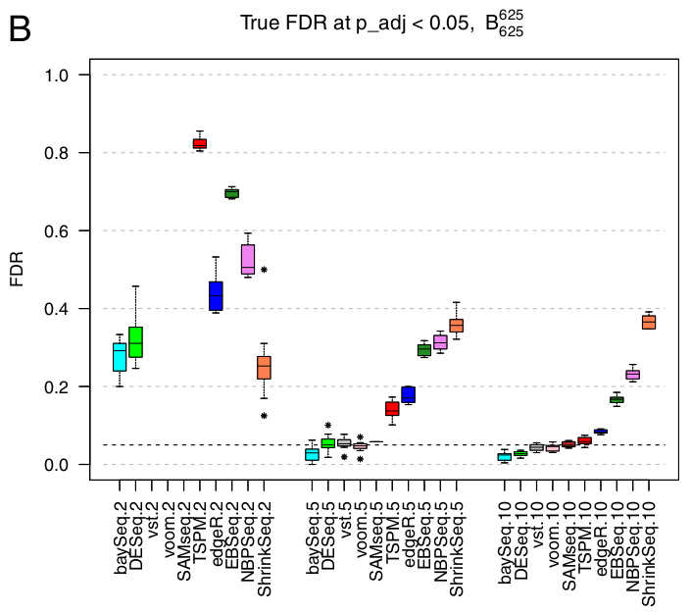
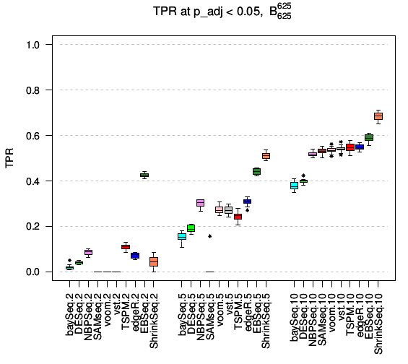
Biological replicates
2
5
10
2
5
10
Samples per condition
Soneson & Delorenzi 2013 BMC Bioinformatics
Notes:
<number>

Slide 33
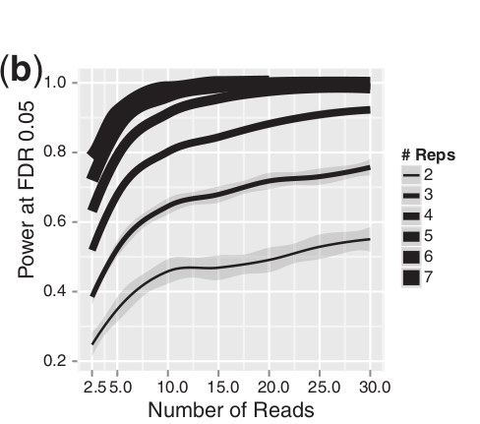
More reads or more replicates ?
From Liu et al. 2014. RNA-seq differential expression studies: more sequence or more replication?

Slide 34
More reads or more replicates ?
Generally more replicates should be
preferred if they can be obtained.
for a fixed total
of 60M reads
6 reps - 10M
4 reps - 15M
2 reps - 30M
From Liu et al. 2014. RNA-seq differential expression studies: more sequence or more replication?

Slide 35
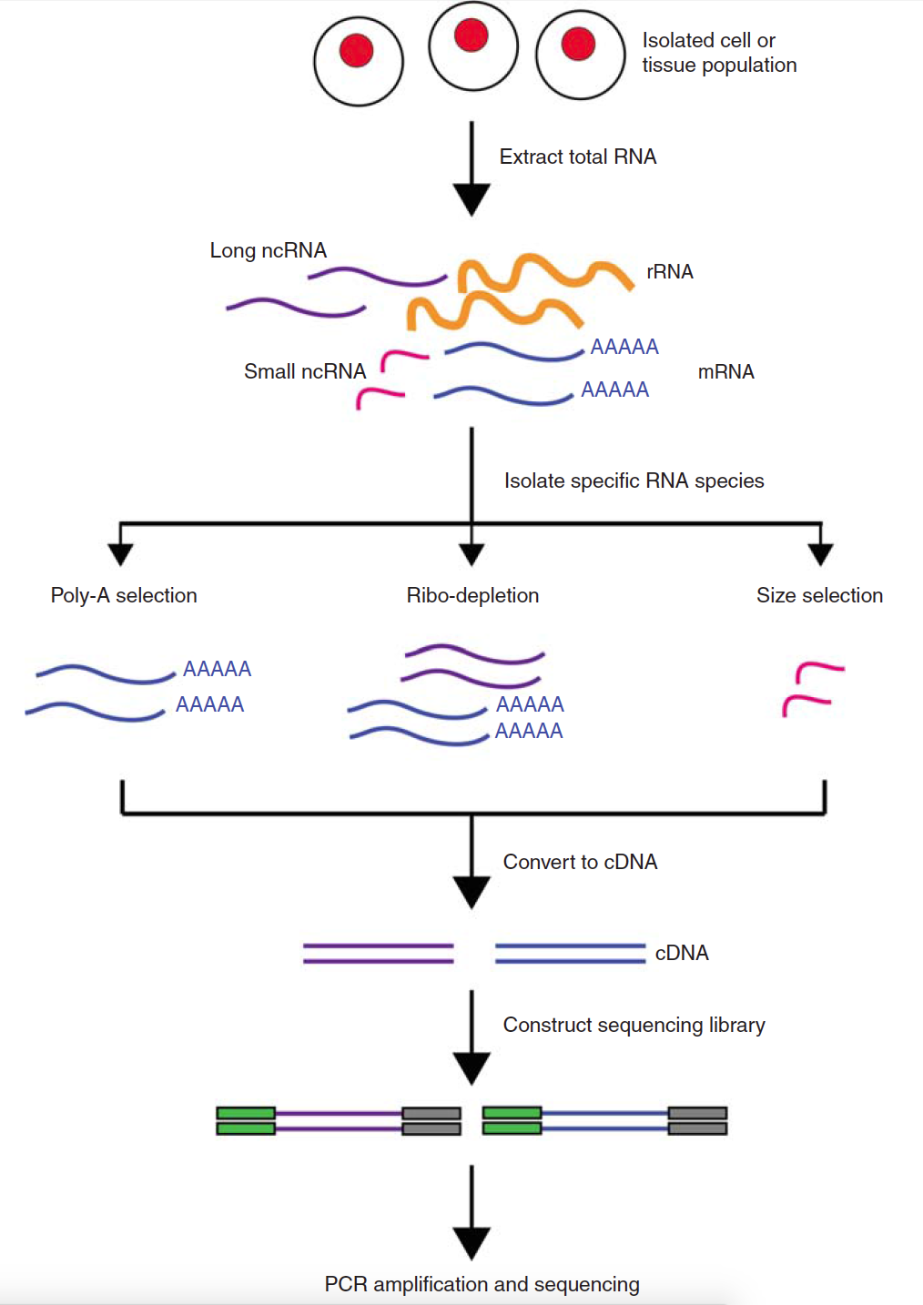
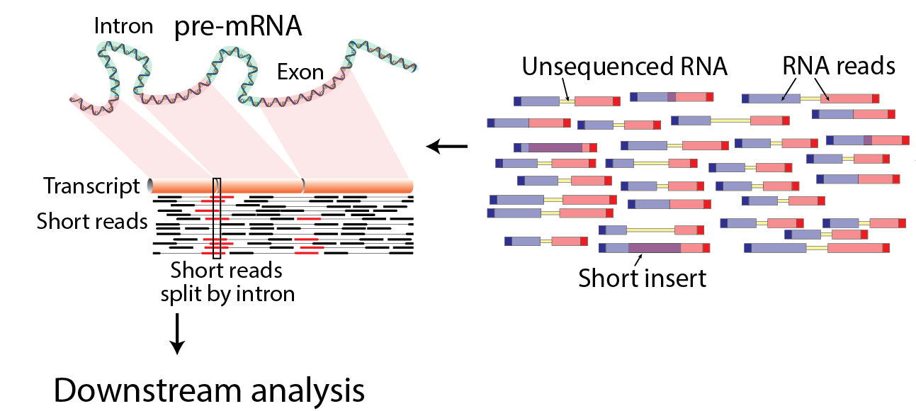
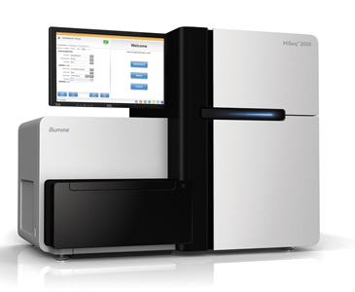
Basic RNA-Seq Protocol Overview

Slide 36
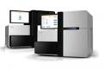
RNA-seq data analysis – basic analysis
Raw reads
Sequencing
facility
mapping
Mapped reads
normalization
across libraries
Expression
matrix
expression
quantification
Normalized
counts
...
Pathway enrichment
analysis
Differential
Expression analysis
Table of DE genes/transcript
...

Slide 37
RNA-seq data analysis – with trimmed reads
Raw reads
trimming/filtering
Trimmed/filtered
reads
Sequencing
facility
mapping
Mapped reads
normalization
across libraries
Expression
matrix
expression
quantification
Normalized
counts
...
Pathway enrichment
analysis
Differential
Expression analysis
Table of DE genes/transcript
...

Slide 38
RNA-seq data analysis – main QC steps
Raw reads
trimming/filtering
Trimmed/filtered
reads
QC
QC
Sequencing
facility
mapping
Mapped reads
QC
normalization
across libraries
Expression
matrix
expression
quantification
QC
Normalized
counts
...
Pathway enrichment
analysis
Differential
Expression analysis
Table of DE genes/transcript
...

Slide 39
RNA-seq data analysis – main QC steps
Raw reads
trimming/filtering
Trimmed/filtered
reads
QC
QC
Sequencing
facility
mapping
Exclude
outlier
Mapped reads
QC
normalization
across libraries
Expression
matrix
expression
quantification
QC
Normalized
counts
...
Pathway enrichment
analysis
Differential
Expression analysis
Table of DE genes/transcript
...

Slide 40
RNA-seq data analysis – not only differential expression
Raw reads
trimming/filtering
Trimmed/filtered
reads
Sequencing
facility
mapping
Mapped reads
normalization
across libraries
Expression
matrix
expression
quantification
variant
calling
isoform
description
Normalized
counts
...
Pathway enrichment
analysis
...
Differential
Expression analysis
Table of DE genes/transcript
...

Slide 41
RNA-seq data analysis – de novo transcriptome assembly
Raw reads
trimming/filtering
Trimmed/filtered
reads
Sequencing
facility
assembly
Assembled
transcriptome
normalization
across libraries
Expression
matrix
expression
quantification
variant
calling
isoform
description
Normalized
counts
...
Pathway enrichment
analysis
...
Differential
Expression analysis
Table of DE genes/transcript
...

Slide 42
RNA-seq data analysis – program for this course
Raw reads
trimming/filtering
Trimmed/filtered
reads
QC
QC
Sequencing
facility
mapping
Mapped reads
QC
normalization
across libraries
Expression
matrix
expression
quantification
QC
Normalized
counts
Pathway enrichment
analysis
Differential
Expression analysis
Table of DE genes/transcript
...

Slide 43
Contributors: Wandrille Duchemin
Geoffrey Fucile Walid Gharib Pablo Escobar Lopez Charlotte Soneson Mihaela Zavolan

Slide 44
RNA-seq data analysis
Raw reads
trimming/filtering
Trimmed/filtered
reads
QC
QC
Sequencing
facility
mapping
assembly
QC
Mapped reads
Assembled
transcriptome
QC
normalization
across libraries
Expression
matrix
expression
quantification
variant
calling
QC
isoform
description
Normalized
counts
...
Pathway enrichment
analysis
...
Differential
Expression analysis
Table of DE genes/transcript
...

Slide 45
Experimental design resources
Local sequencing facility and/or bioinformatics unit
https://genome.ucsc.edu/ENCODE/protocols/dataStandards/ENCODE_RNAseq_Standards_V1.0.pdf
http://seqanswers.com/
https://www.biostars.org

Slide 46
Complex protocols:
CLIP
Crosslinking with
254 nm UV light
4-thiouridine treatment
Crosslinking with
365 nm UV light
AAAA
AAAA
A)
Small RNA seq
B)
PAR-CLIP
C)
CLASH
D)
HITS-CLIP
Immuno-precipitation
Cell lysis
Immuno-precipitation
RNase treatment
Radioactive Phosphorylation
RNase treatment
RNase treatment
P
OH
Ni-NTA binding
Immuno-precipitation
P
AAAA
³²P
Gu-HCl washing
PNK treatment
AAAA
OH
Y
PNK treatment
3’ adapter ligation
Gel purification
Proteinase K treatment
P
Intermolecular
ligation
³²P
Y
³²P
Gel purification
P
OH
Proteinase K treatment
3’ adapter ligation
RNA-RNA hybrid
³²P
E)
iCLIP
3’ adapter ligation
PNK treatment
5’ adapter ligation
P
³²P
Reverse transcription
5’ adapter ligation
Ni-NTA elution
Circularization
Gel purification
Proteinase K treatment
5’ adapter ligation
Linearization
Adapter-flanked insert
PCR amplification
Mittal & Zavolan
Genome Biology 2014
cDNA synthesis
PCR amplification
Sequencing
Data Analysis
Notes:
<number>

Slide 47
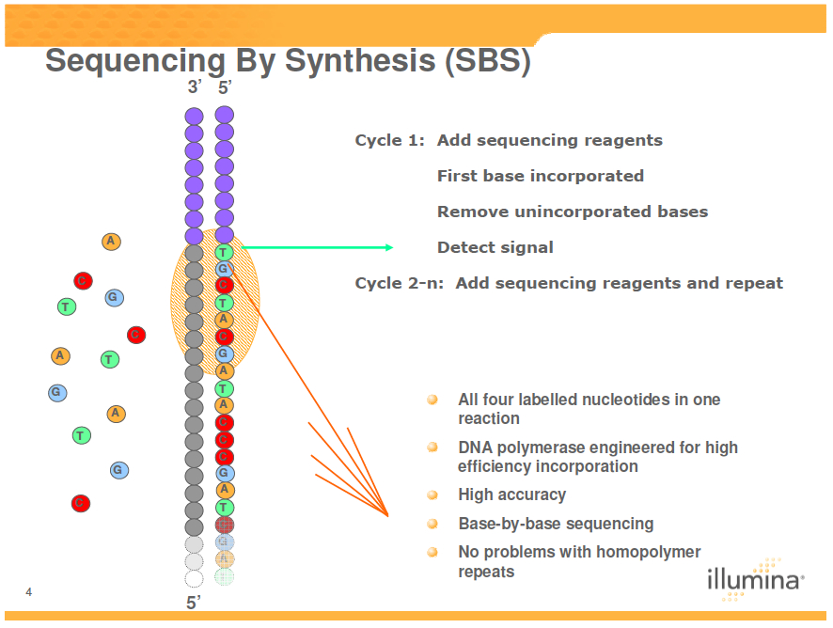
Illumina sequencing – “sequencing by synthesis”

Slide 48
What (and why) are we sequencing?
Transcriptomics
Total RNA sequencing
PolyA+ RNA sequencing
Ribozero
Genome annotation
Allele-specific expression
Transcript identification (lncRNAs)
Alternative splicing
Gene Fusion
5`/3` tag sequencing
Gene expression analysis
Small RNA sequencing
Identification and expression analysis of small RNAs (eg miRNAs)
Metabolic labeling – RNA Seq
Analysis of mRNA decay
Crosslinking and immunoprecipitation of RNA-binding proteins (CLIP)
Binding sites of RBPs
Ribosome footprinting
Analysis of mRNA translation
Ribometh-seq and similar
Detection of RNA modifications
Single-cell transcriptomics
Imagination is the limit!
A longer but non exhaustive list :
https://liorpachter.wordpress.com/seq/

Slide 49
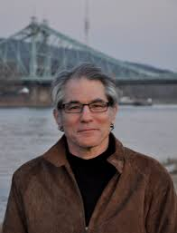
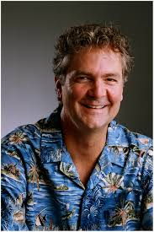

Beginning of sequencing: Sanger’s method
Could be applied to wide range of fragment lengths, used initially in whole genome sequencing
Extract, purify and fragment genomic DNA
Make clone library
Sequence clone
Assemble the genome
Fill gaps
Computationally intensive for alignment and assembly
Gene Myers
Frederick Sanger
David Haussler

Slide 50
Sanger sequencing method
Uses chain terminating nucleotides which are stochastically incorporated
Gel electrophoresis allows one to ’read’ the sequence
A
C
G
T
AGTAGTGTGTGCCCGTCTGTTCGTATCTTCTTGCGCTTCA
AGTAGTGTGTGCCCGTCTGTTCGTATCTTCTTGCGCTTC
AGTAGTGTGTGCCCGTCTGTTCGTATCTTCTTGCGCTT
AGTAGTGTGTGCCCGTCTGTTCGTATCTTCTTGCGCT
AGTAGTGTGTGCCCGTCTGTTCGTATCTTCTTGCGC
AGTAGTGTGTGCCCGTCTGTTCGTATCTTCTTGCG
AGTAGTGTGTGCCCGTCTGTTCGTATCTTCTTGC
AGTAGTGTGTGCCCGTCTGTTCGTATCTTCTTG
AGTAGTGTGTGCCCGTCTGTTCGTATCTTCTT
AGTAGTGTGTGCCCGTCTGTTCGTATCTTCT
AGTAGTGTGTGCCCGTCTGTTCGTATCTTC
AGTAGTGTGTGCCCGTCTGTTCGTATCTT
AGTAGTGTGTGCCCGTCTGTTCGTATCT
AGTAGTGTGTGCCCGTCTGTTCGTATC
3’
5’

Slide 51
Underlying principle
Sequencing by synthesis
Sanger/Dideoxy chain termination – 1st generation
Pyrosequencing (Roche/454) – 2nd generation
Reversible terminator (Illumina) – 2nd generation
Ion torrent (Life Technologies) - 3rd generation
Zero Mode Waveguide (Pacific Biosciences) - 3rd generation
Sequencing by Oligo Ligation Detection
SOLiD (Applied Biosystems) – 2nd generation
Direct reading of DNA/RNA sequence
Nanopore sequencing – 3rd generation
Notes:
<number>

Slide 52
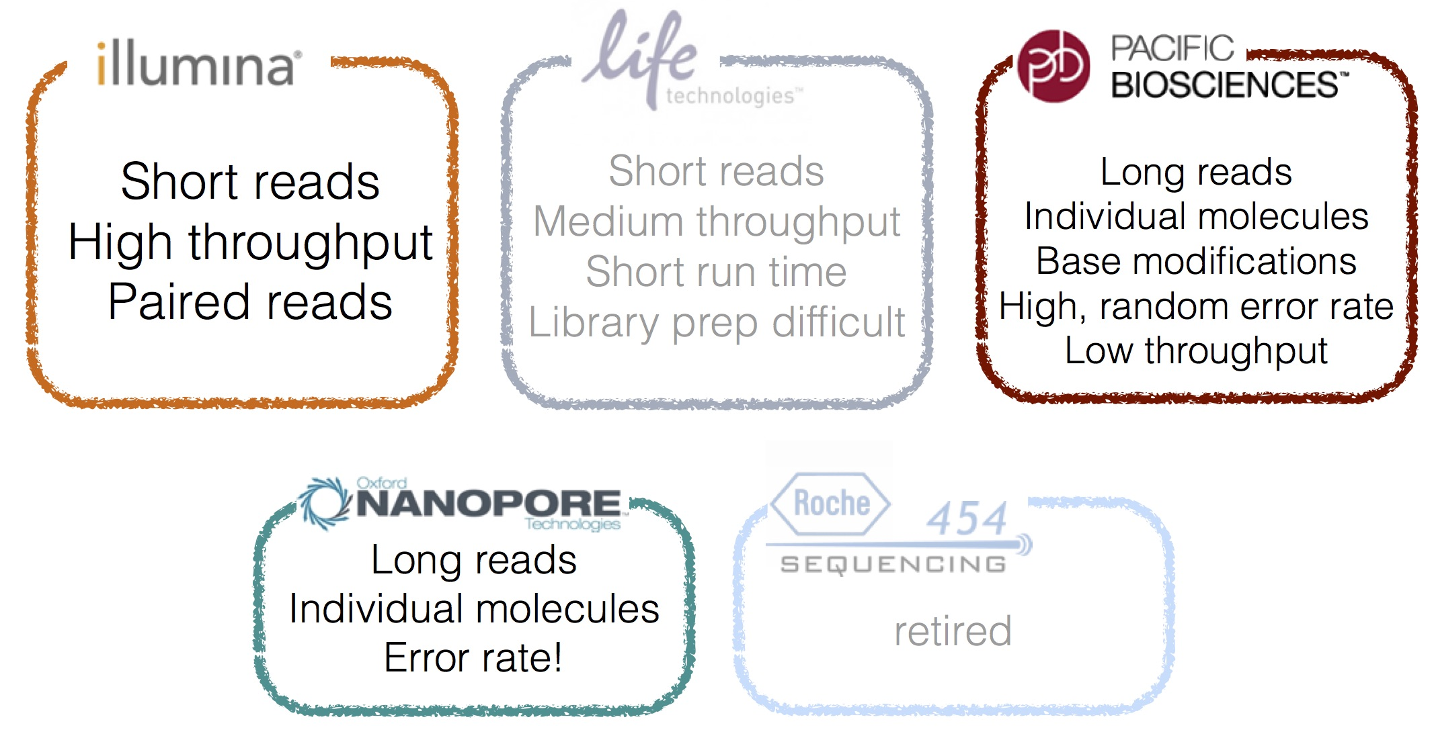
Major technologies
SOLiD

Slide 53
Read lengths
assembled
single molecule

Slide 54
File formats in RNA-Seq workflow
Raw data | FastQ
Alignments | SAM, BAM, CRAM
Genome annotation | GFF
Intervals | BED
Variants | VCF, BCF
Continuous data | WIG, bedGraph
http://genome.ucsc.edu/FAQ/FAQformat.html

Slide 55
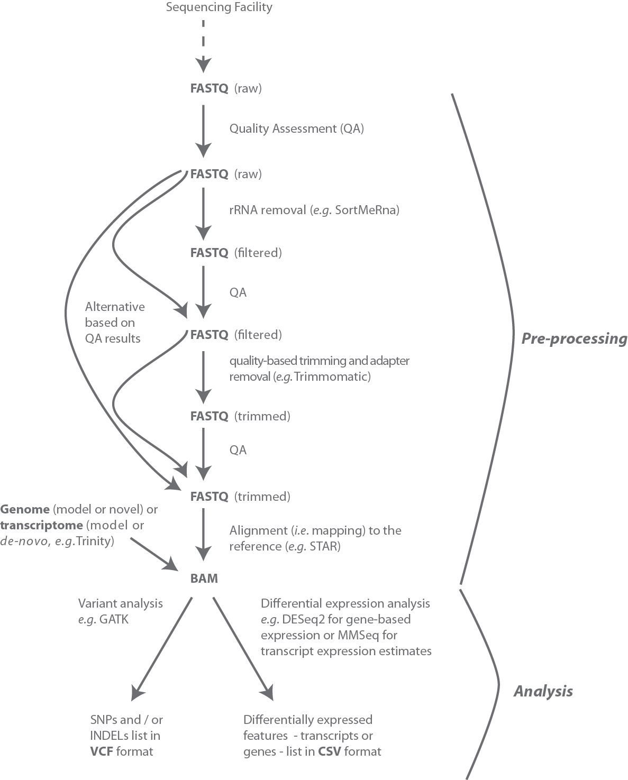
File formats in RNA-Seq workflow

Slide 56
RNA-Seq Quality Control
FASTQ files have a per base quality score (covered in detail later). There are many tools to evaluate sequencing quality and perform trimming/modification
A post-hoc method to detect low quality data:
Transcript integrity number (TIN) estimates the uniformity of coverage of a transcript by reads → degraded transcripts have poor 5` coverage
Uniformity of coverage estimated as Shannon entropy of read frequency per position, take median over transcript
Read coverage profile
5’
3’
Cap
Poly(A)
Wang et al BMC Bioinformatics 2016

Slide 57
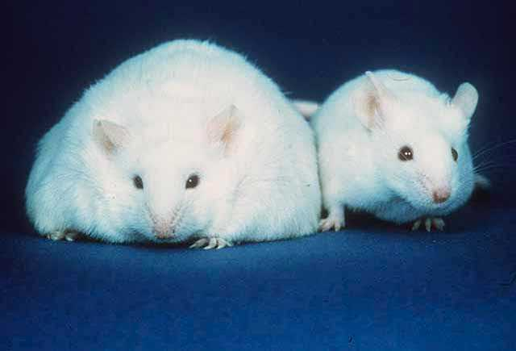
RNA-Seq for differential gene expression
Typically: which genes are expressed at higher/lower levels in the treated versus control samples?

